Slide 1
Week 5 – Case Interviews and GitHub
Final Preparation Steps for a Career or Internship
Feb. 20, 2026

Slide 2
Topics for Today
Case Interviews
GitHub
Next Week

Slide 3

Case Interviews
Can you think on the fly?

Slide 4
Case Interviews
What is a case?
Simply – A verbal analysis of a business question
Why do companies use case interviews?
Allows company to see your thought process
Showcases your analytical and creative abilities
Tests your ability to think quickly (on-the-fly)

Slide 5
Types of Case Interviews
Open-ended Cases
Broad question – usually a few sentences long
Make assumptions and discuss thought process
Structured Cases
Generally, a one-on-one case
Guided case - Walked through problem-solving process
Paper-driven cases
Given a deck of information (graphs, spreadsheets, statements)
Asked to review information and provide insight

Slide 6
Structured Case
Must talk through your thought process out loud
Only 1 -2 “quiet” pauses during process
Generally, 20 – 30 min long
Timing:
5-10 min for understanding the problem (stage 1) and creating a structure (stage 2)
5–10 min for conducting analysis (stage 3)
3 min for conclusion and recommendation
Note: Remaining time used by interviewer providing information

Slide 7

Stages of a Case – Stage 1
1. Understand the Problem
Listen
Take quick notes – bullets w/1-3 words
Ask clarifying questions
Repeat what you heard
Confirm information provided

Slide 8
Stages of a Case – Stage 2
2. Develop Structured Approach
Ask for a moment to gather thoughts
Outline approach
Create list of hypotheses and considerations
Discuss approach with interviewer

Slide 9

Stages of a Case – Stage 3
3. Conduct Analysis
Ask questions to validate hypotheses
Discuss global considerations and industry trends
Use feedback to guide analysis and recommendations
Perform calculations, if requested

Slide 10
Stages of a Case – Stage 4
4. Summarize and Recommend
Repeat key issues
Answer original question(s)
Provide conclusion
Provide recommendation based on data and analysis

Slide 11
Practice a Case Interview
FIRST:
1
Always bring blank sheets of paper
Always bring a pencil
SECOND:
2
Turn paper landscape
Create a 3-section T-grid

Slide 12
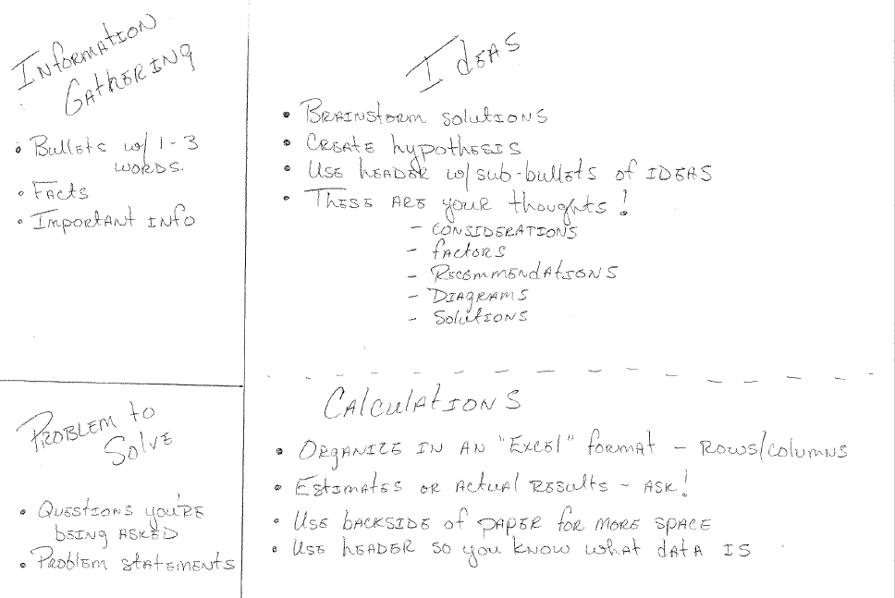
Your Case Worksheet
Information Provided
Process and Plan
Problem(s) to Solve

Slide 13
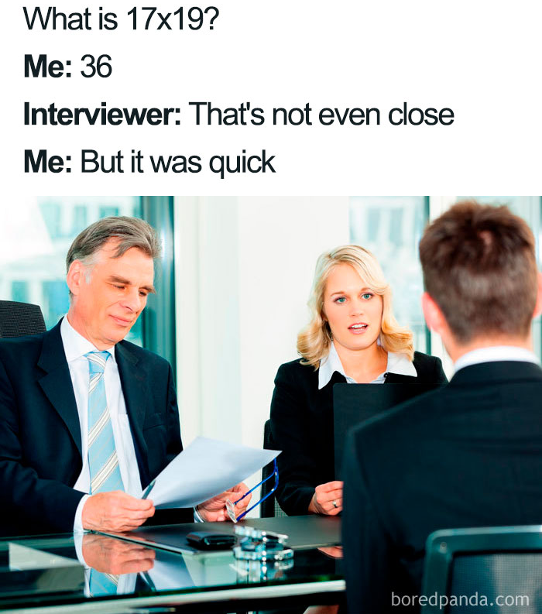
Remember This!
No calculators!
Estimate using easy to calculate numbers
Think in 3’s for Ideas and Sub-bullets

Slide 14
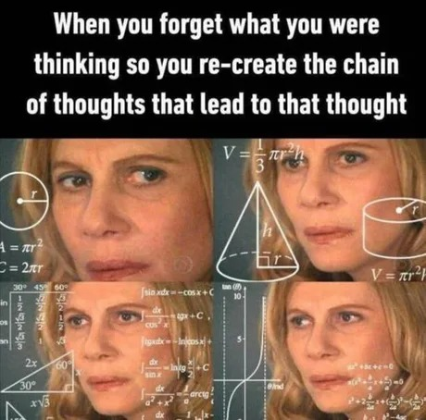

Why We Use This Process!!

Slide 15
Case Interview Practice Samples
Deliotte Interactive Case Examples
Nick Singh’s Ace the Data Science Site (DataLemur)
Reddit Sample w/Commentary
U Penn Case Book with Examples

Slide 16
More Case Interview Examples
General Case Study Videos
Case Interview 101
Case Interview – How to Open Any Case, Perfectly
Observational View Case
McKinsey Sample Case Question
Data Science Business Case Study Videos
Netflix Pricing
Walmart Pricing Algorithm

Slide 17
Your Turn
Now, let’s give it a try!

Slide 18
GitHub
Use on your resume

Slide 19

Key Aspects of GitHub
Version Control: A tool that tracks changes made to files, allows people to revert to previous versions
Cloud Hosting: Access repositories from anywhere
Collaboration: Easy for teams to work together
Organization: Projects are organized into repositories

Slide 20

A Great Way to Showcase Your Skills!

Slide 21
Getting Started
How to Use GitHub for Beginners
Learn more through:
LinkedIn Learning – Free to U of Iowa students
https://skills.github.com/ - Learn how to use GitHub with short interactive activities
Upload source code and project samples
Add GitHub public link to your resume

Slide 22
GitHub Page Samples
Create a repository
Kris Arens: https://github.com/kristinearens
Create a Website (These are called GitHub pages)
Kris’ Sample: https://kristinearens.github.io/testpage-main/

Slide 23
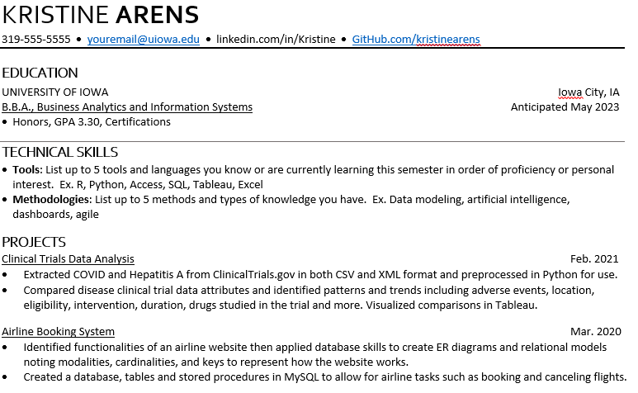
GitHub on Resumes
Showcase your work
Match repository to projects
Provide:
Code examples
Presentations
Data Analysis

Slide 24
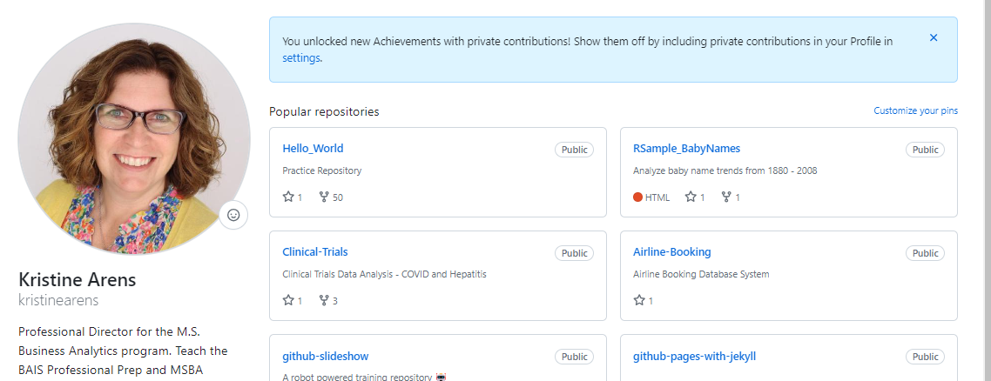
Let’s Take a Look
https://github.com/kristinearens

Slide 25
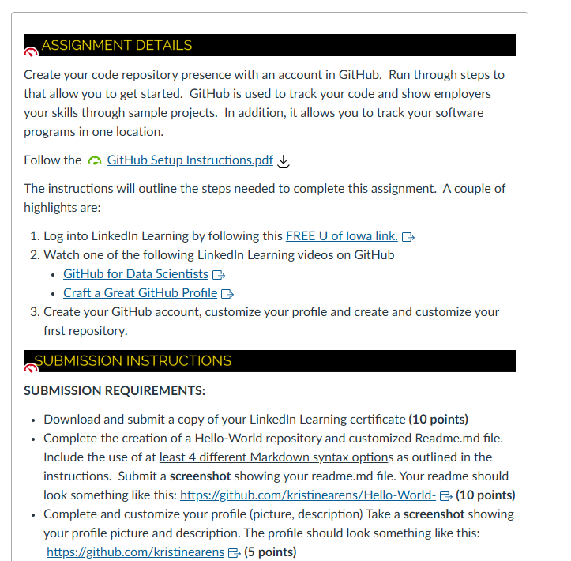
Now Let’s Try Ourselves
Download the GitHub Setup Instructions
Create a GitHub account
Upload a photo
Add Your Bio info
Create a Repository
Update the README.md file

Slide 26
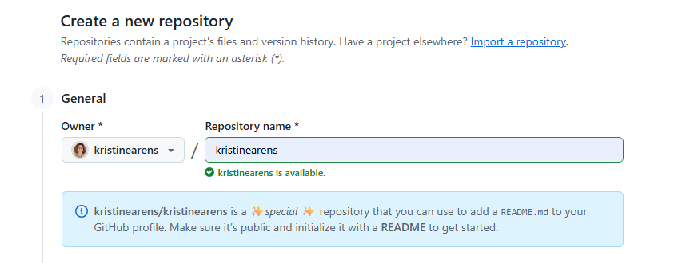
Let’s Add a Little Flare!

Slide 27
Next Week
Let’s hear from the professionals!

Slide 28

Next Week
Industry Panel
Negotiating Your Offer

Slide 29
Industry Panelists
Who will we chat with?

Slide 30
Panelists
Brandon Miller, Partner @ EY (2003 Accounting and Information Systems Grad) LinkedIn
Anna Kroeger, Senior Consultant, Deloitte, Chicago (2020 BAIS and Mgmt Grad) - via Zoom - LinkedIn
Lewis Vander Waal, Business Intelligence Analyst, Holmes Murphy (2019 BAIS Grad) - LinkedIn
Brandon Rollinger, Enterprise Applications Manager, ESCO Group – Scintilla (2021 Comp Sci Grad) - LinkedIn

Slide 31
Panelist Questions
Future Impact of AI
How do you think AI will change the Business Analytics industry (including positives and negatives)?
With the rapid growth of AI, how can you stand out in analytics?
What emerging trends in your field should students start paying attention to now?
Getting Hired
What advice or tips do you have to "sell yourself" or make a great impression on recruiters hiring interns or full-time?
What technical skills standout the most to employers?
What is one thing you wish you knew before you started your career?
Understanding the Industry
What skills or experiences have you found most valuable in advancing your career? How can students develop them now?
What are common tools you use? How deeply do you think you need to know them?
If you were in our shoes today, would you focus on mastering one specific tool (like SQL) or being a generalist across many?
How easy is it to balance work life and regular life? What does the workload look like?
What is the biggest thing you see people struggle with converting from a student to an employee in the workforce?
Understanding the Major
How closely did coursework relate to work in the industry?
How does BAIS tie into other majors such as marketing, accounting and finance? Should I double-major?

Slide 32
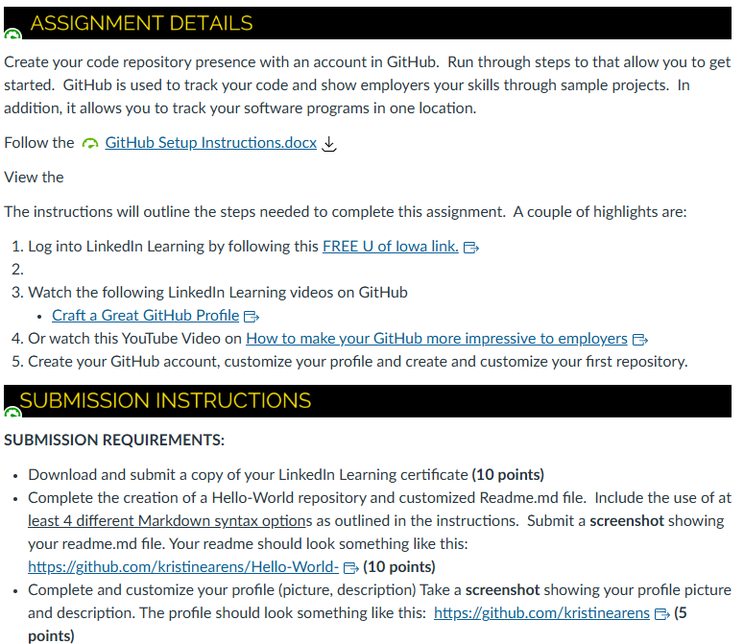
GitHub Assignment
This is a required assignment!
➔ You must complete this assignment to pass this class.

